Slide 1
Mirror Image Rule
Richard Warner
​

Slide 2
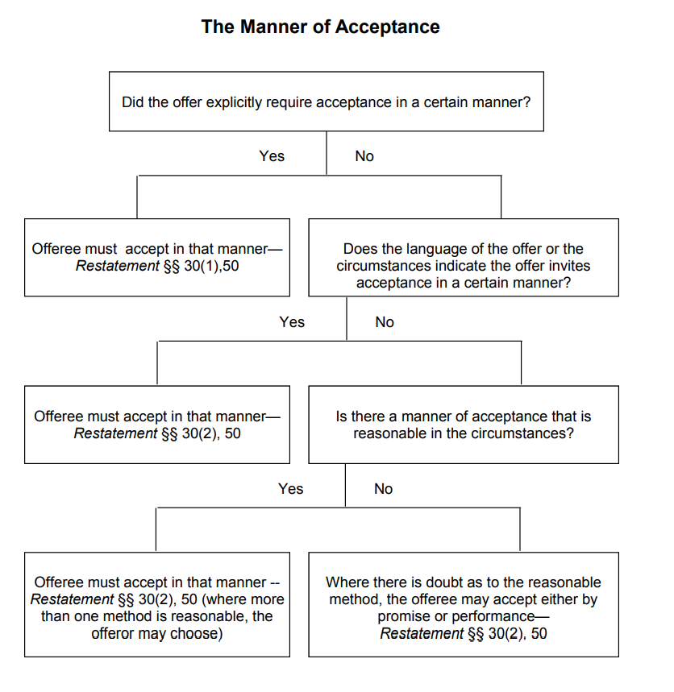

Slide 3


Mirror Image Rule
Communication that attempts to accept
Communication that succeeds in accepting
Two formulations:
  An acceptance is not effective if it contains terms that differ from the offer.
  An expression of acceptance is effective only if it does not contain terms that differ from the offer
Example: Alice, “I offer to sell you my pen for $10.” Bob, “I accept—a refill included.”
  Alice: “I offer to write your essay for $10.” Bob: “I accept—you guarantee and A.”
  Bob’s acceptance (= his attempt to accept) is not effective (= not effective as an acceptance).

Slide 4

Ardente v. Horan
The Horans offered to sell their house to Ardente for $250,000. Did Ardente accept the offer?
The offer was in the form of a purchase and sale agreement sent by the Horans to Ardente. Ardente signed the agreement and sent it back.
  If that is all he had done, that would have been an acceptance.
But he also included a letter requesting that the Horans confirm that certain pieces of personal property were also included in the deal.
Before we focus on the particular facts, let’s review the possibilities.

Slide 5
A Misunderstanding
Suppose Ardente and Horan had a misunderstanding about the furniture when negotiating the contract.
  Ardente thought it was included in the price; Horan did not.
Ardente finally gave in, saying, “I’ll take the house at $250,000 without the furniture, but maybe you will still change your mind. I still think you promised to include the furniture. I’ll send a note about that back with the contract.”

Slide 6


Carving Up The Communication
Signed agreement to sell real estate
The acceptance , which exactly matches the offer
An offer to make a another contract (or to modify the one just formed)
+
Furniture included
“However, an acceptance may be valid despite conditional language if the acceptance is clearly independent of the condition. Many cases have so held. Williston states the rule as follows: ‘Frequently an offeree, while making a positive acceptance of the offer, also makes a request or suggestion that some addition or modification be made. So long as it is clear that the meaning of the acceptance is positively and unequivocally to accept the offer whether such request is granted or not, a contract is formed.’”

Slide 7
Disagreement
Ardente and Horan had a misunderstanding about the furniture when negotiating the contract. Ardente thought it was included in the price; Horan did not. They argued about it with no resulting agreement. When Ardente signs the contract, he adds a note that reads “price includes the furniture.” Is the note plus agreement an acceptance under the mirror image rule?
(a) True
(b) False

Slide 8

No Carving Up The Communication
Signed agreement to sell real estate
The acceptance, which does not exactly matches the offer
+
Furniture included

Slide 9
The Actual Communication In The Case
Ardente’s “attorney returned the document to defendants along with a check in the amount of $20,000 and a letter dated September 8, 1975, which read in relevant part as follows:
  My clients are concerned that the following items remain with the real estate: a) dining room set and tapestry wall covering in dining room; b) fireplace fixtures throughout; c) the sun parlor furniture. I would appreciate your confirming that these items are a part of the transaction, as they would be difficult to replace.”
The court holds this violates the mirror image rule and is thus not an acceptance. So the court must have refused to divide the communication into an acceptance part and something else.
(a) Yes
(b) No

Slide 10
The Court’s Explanation
“There is no doubt that the execution and delivery of the purchase and sale agreement by plaintiff, without more, would have operated as an acceptance. The terms of the accompanying letter, however, apparently conditioned the acceptance upon the inclusion of various items of personalty. In assessing the effect of the terms of that letter we must keep in mind certain generally accepted rules. To be effective, an acceptance must be definite and unequivocal. “An offeror is entitled to know in clear terms whether the offeree accepts his proposal. It is not enough that the words of a reply justify a probable inference of assent.” 1 Restatement Contracts §58, comment a (1932). The acceptance may not impose additional conditions on the offer, nor may it add limitations. "An acceptance which is equivocal or upon condition or with a limitation is a counteroffer and requires acceptance by the original offeror before a contractual relationship can exist." John Hancock Mut. Life Ins. Co. v. Dietlin, 97 R.I. 515, 518, 199 A.2d 311, 313 (1964).”

Slide 11
Sowle and McCartney
Steve Sowle owns and operates Sole Saver, Your Sowle Stop for Shoe Repair. Paul McCartney owns and operates Rubber Sole, a supplier of rubber soles to shoe repair shops. Sowle sends the following letter to McCartney: Please quote me your lowest price on 500 natural rubber soles for delivery on November 1. When McCartney receives the note, he calls Sowle to discuss the price and quality. During the conversation, Sowle says, “If you can get me 500 red, white, blue shoe strings for $500, I would almost certainly say “yes” to that deal.” “An unusual request,” says McCartney, “but, yes, I know where I can get a lot of those things; out on Highway 61 from Abraham and Son. So sure, I will deliver the shoe strings along with the rubber soles.” Sowle replies, “Great. It’s a deal on the shoe strings. Send along your purchase agreement for the rubber soles.” McCartney signs and sends a purchase agreement filled out by him for 500 rubber soles for $500. On October 2, Sowle signs and returns the purchase agreement and includes the following note: I accept your offer of 500 rubber soles at $1 a sole. Delivery to be on November 1. Nice to reach an agreement. Great that we have a deal!
McCartney offered to sell Sowle the shoe strings.
(a) True
(b) False

Slide 12
Sowle and McCartney
Steve Sowle owns and operates Sole Saver, Your Sowle Stop for Shoe Repair. Paul McCartney owns and operates Rubber Sole, a supplier of rubber soles to shoe repair shops. Sowle sends the following letter to McCartney: “Please quote me your lowest price on 500 natural rubber soles for delivery on November 1.” When McCartney receives the note, he calls Sowle to discuss the price and quality. During the conversation, Sowle says, “If you can get me 500 red, white, blue shoe strings for $500, I would almost certainly say “yes” to that deal.” “An unusual request,” says McCartney, “but, yes, I know where I can get a lot of those things; out on Highway 61 from Abraham and Son. So sure, I will deliver the shoe strings along with the rubber soles.” Sowle replies, “Great. It’s a deal on the shoe strings. Send along your purchase agreement for the rubber soles.” McCartney signs and sends a purchase agreement filled out by him for 500 rubber soles for $500. No delivery date. On October 2, Sowle signs and returns the purchase agreement and includes the following note: I accept your offer of 500 rubber soles at $1 a sole. Delivery to be on November 1. Nice to reach an agreement. Great that we have a deal!
Under the mirror image rule, Sowle failed to accept McCartney’s offer concerning the rubber soles.
(a) True
(b) False

